Slide 1


Slide 2
Project Statements
Rapid Spread of Misinformation
In today’s digital world, misinformation spreads rapidly through news articles and social media platforms.
Impact on Society
HEADING HERE
The spread of fake news poses serious risks to public trust, political stability, and public safety.
Limitations of Manual Fact-Checking
Manual fact-checking methods are slow, resource-intensive, and ineffective for real-time verification.
Purpose of the Detection Tool
The Fake News Detection & Verification Tool is designed to automatically identify and analyze suspicious content.
Use of Advanced Technologies
The system leverages Natural Language Processing (NLP), deep learning models, and real-time fact-checking APIs to assess credibility.
Explainable and Verified Results
The tool provides explainable outputs by highlighting doubtful claims and linking users to reliable, verified sources.

Slide 3
1
Automated detection with a credibility probability score ranging from 0 to 1.
2
Verification of factual claims using real-time checking mechanisms.
3
Explainable results with highlighted keywords and suspicious patterns.
System Outcomes
4
Evaluation and scoring of content based on the credibility of its source.
Detection and analysis of fake news across multiple languages.
5
6
User-friendly dashboard to visualize and explore detection results.

Slide 4
Technologies Used
Web & Backend Technologies
Flask / FastAPI
JWT Authentication
Docker deployment
04
APIs & Databases
Google Fact Check Tools API
PolitiFact API
SQL / NoSQL storage
03
Machine Learning / Deep Learning
Transformer models: BERT, RoBERTa, DistilBERT
Fine-tuning for classification
02
NLP Technologies
Tokenization, Stopword removal
Lemmatization (spaCy, NLTK)
Named Entity Recognition (NER)
Dependency Parsing
01

Slide 5
User Authentication & Profile Management
Registration and login system using JWT authentication.
User profiles to manage submitted articles and analysis history.
Analysis History & User Interaction Module
• Stores and displays the history of all analyses performed by users.
• Allows users to view detailed results of past analyses (probability score, verdict, highlighted text, and sources).
• Provides user profile integration to track submissions, timestamps, and outcomes.
• Enables easy navigation between analysis history and detailed reports through an interactive UI.
News Article & Social Media Post Ingestion Module
Paste or upload text, or fetch content from a URL/social media link.
Text extraction and cleaning (handling hashtags, emojis, metadata).
01
02
08
NLP Preprocessing & Feature Extraction Module
Tokenization, stopword removal, and lemmatization using NLTK/spaCy.
Named Entity Recognition (NER) to identify people, places, and organizations.
03
Admin Dashboard
Manage trusted source lists and API keys.
Monitor system performance and usage statistics.
Modules Implemented
07
Fake News Classification Module
Transformer-based models (e.g., BERT, RoBERTa) fine-tuned on fake news datasets.
Output: Probability score (0–1) and classification (real/suspicious/fake).
04
Explainability & Visualization Module
Highlight suspicious phrases in the text.
Display verification results with supporting source links.
06
05
Claim Verification Module
Extract factual claims using dependency parsing and NER.
Verify claims against trusted fact-checking APIs and databases.

Slide 6
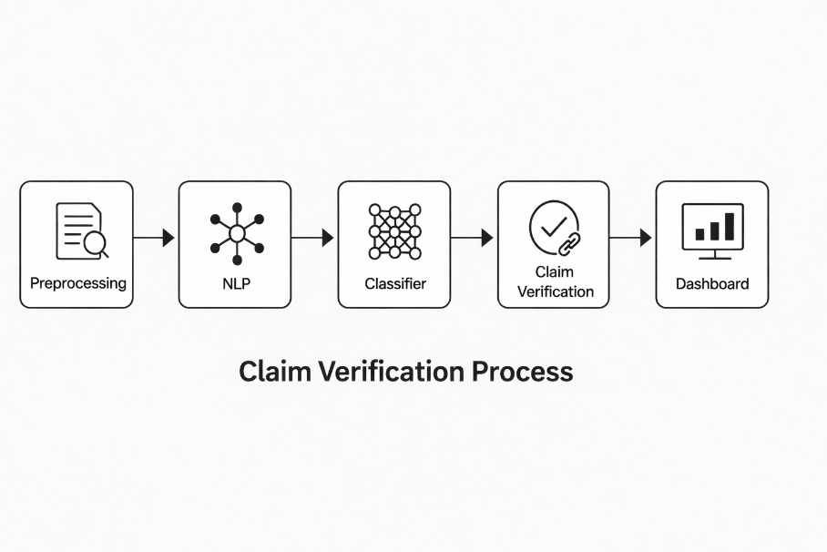
ARCHITECTURE DIAGRAM
User → Preprocessing → NLP → Classifier → Claim Verification → Dashboard
Dashboard
→
Claim Verification
→
Classifier
NLP
→
→
Preprocessing

Slide 7
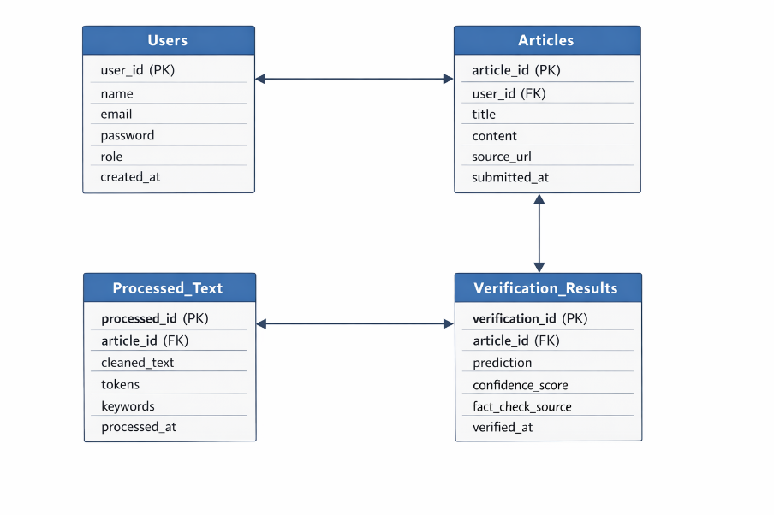
Database / Schema Overview
Stores user account details such as user ID, name, email, password, and role (user/admin).
Users Table
Stores news articles or social media content submitted by users for analysis.
Articles Table
Stores cleaned and preprocessed text after NLP steps like tokenization and stopword removal.
Processed Text Table
Stores named entities (people, places, organizations) extracted from the text using NER.
Entities Table
Stores the final analysis results including credibility score, classification, and verification sources.
Verification Results Table

Slide 8
Feature Enhancement
Transformer-Based Context-Aware Detection
Enhances fake news detection accuracy by understanding the full context of news articles and social media posts.
01
Real-Time Claim Verification
Integrates trusted fact-checking APIs to verify factual claims instantly and reduce misinformation spread.
02
Advanced NLP Preprocessing
Improves analysis quality by cleaning and normalizing text, including hashtags, emojis, URLs, and metadata.
03
Named Entity–Driven Claim Extraction
Identifies key entities such as people, places, and organizations to enable precise claim verification.
04
Probability-Based Credibility Scoring
Provides a confidence score (0–1) to help users clearly assess the reliability of content.
05
Explainable AI Insights
Highlights suspicious phrases and keywords, making the system’s decisions transparent and understandable.
06
Scalable Misinformation Detection System
Supports large-scale content analysis efficiently, making the system suitable for real-world deployment.
07
Interactive Visualization Dashboard
Displays analysis results, credibility scores, and verification sources through an intuitive and user-friendly interface.
08

Slide 9
Conclusion
The Fake News Detection & Verification Tool offers an end-to-end AI-based solution for identifying and verifying misinformation in real time.
01
It effectively combines NLP, deep learning models, and trusted fact-checking sources to improve accuracy and reliability.
02
The system helps enhance information credibility and reduces the spread of false or misleading content.
03
It promotes digital literacy by enabling users to critically evaluate news and online information.
04
The project provides practical, hands-on experience with modern AI technologies applied to large-scale, real-world challenges.
05

Slide 10
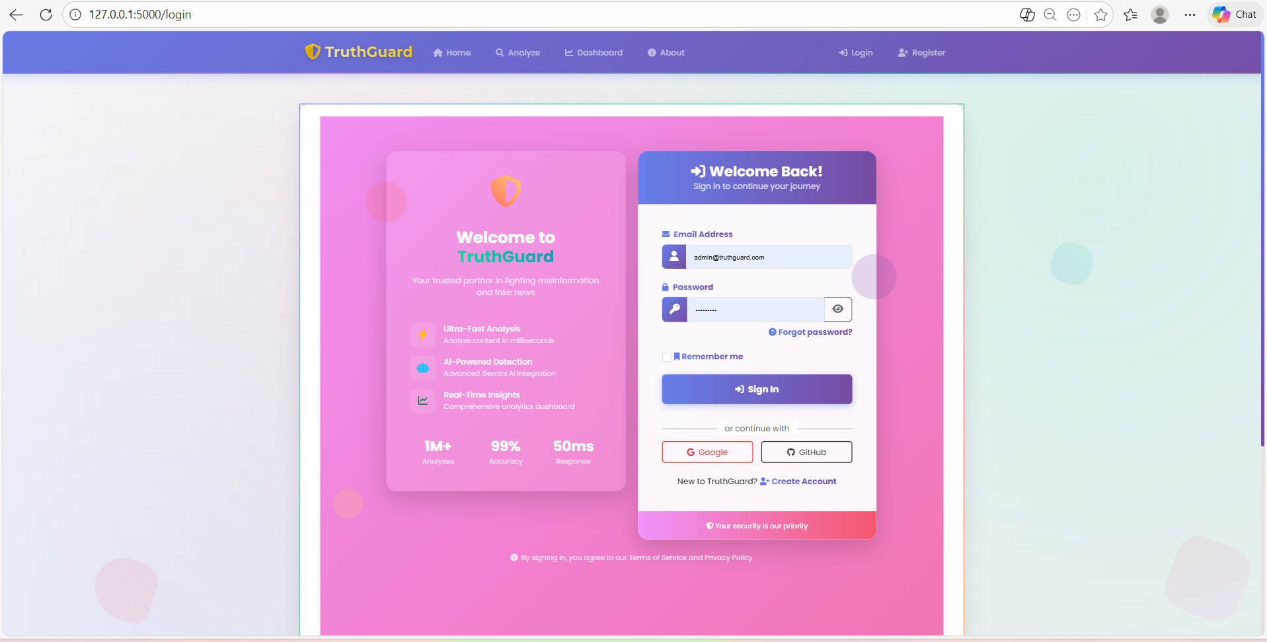

Sample Outputs
Login page
Home page

Slide 11
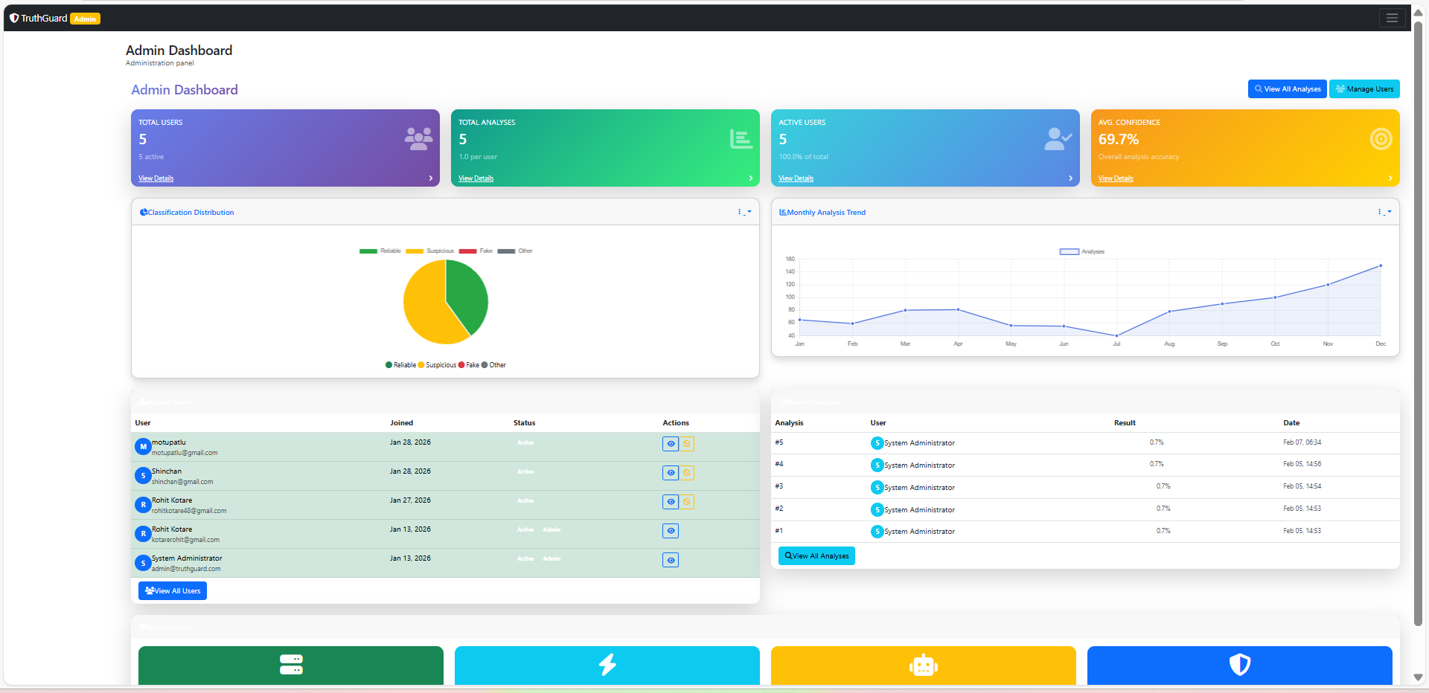
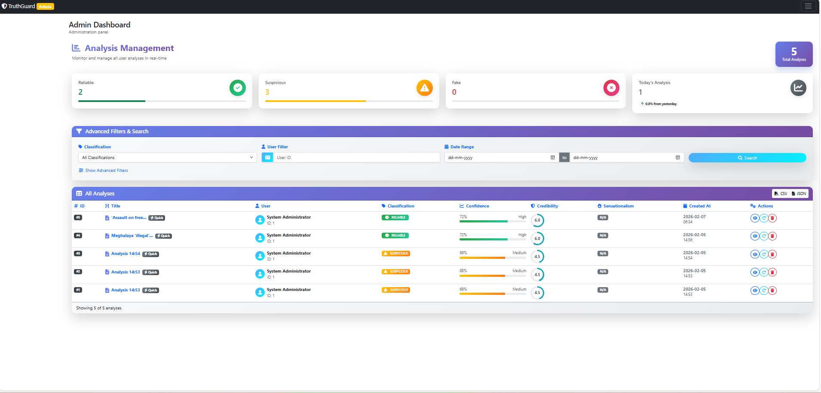
Admin Dashboard
Analysis Management

Slide 12
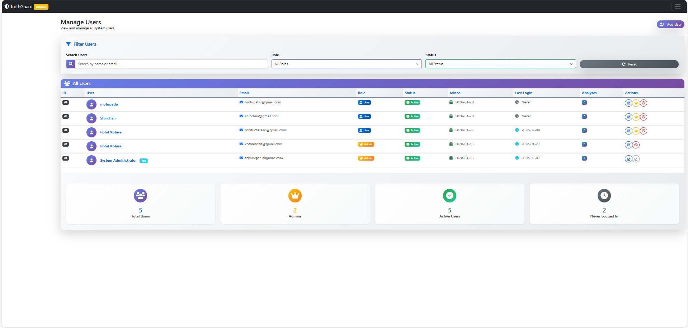
Users

